Slide 1
Travel cost/Km
?
Cheap
Expensive
Standard
Gender
?
Car
Train
Male
Female
Bus
Car ownership
?
0
1
Bus
Train

Slide 2
Travel cost/Km
?

Slide 3
Travel cost/Km
?
Cheap
Expensive
Standard
Split further
Car
Train

Slide 4
Travel cost/Km
?
Cheap
Expensive
Standard
Gender
?
Car
Train
Male
Female
Bus
Split further

Slide 5
Animate Object
Subclass of
Agent
Person
Organization
Manager
Employee

Slide 6
Profile
Subclass of
Skill
Experience
Education
Achievement

Slide 7
Energy Environment Education Economics Transport Trade Labor Agriculture

Slide 9
Tập hợp

Slide 12
Microsoft
Analysis Services
Data Source
Data Source View
Mining Structure
Mining Model
Algorithm name and Parameters
Model content

Slide 13
2. Create Analysis Services Data Source
3. Create Analysis Service Data Source View
4. Select Algorithm and declare parameters
5. Create Mining structures and mining models
7. Export Mining Model data to database (Database Engine)
1. Preprocessing data and export data to view
8. Clean up and close connections
6. Processing Mining Model

Slide 14
Decision Tree
Engine
Taxonomy
DecisionTreeNode table
Algorithm and Parameters
DecisionTreeNodeDistribution table

Slide 15
Product A
Feature
Color
Specification
Feature A
Feature B
Red
Blue
Size
Weight

Slide 16
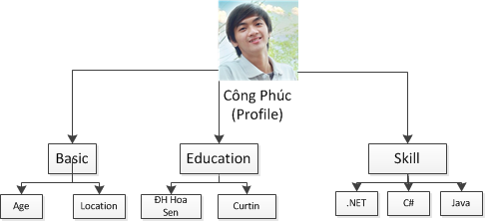
abstract
Node
Component
(Node)
inherit
aggregation
Node
inherit
Node
Leaves
Composite

Slide 17

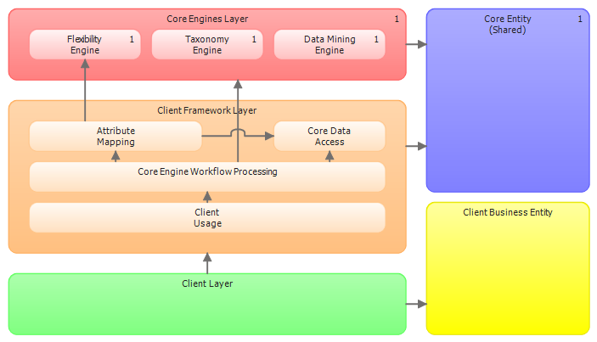



Windows Services Tier
Taxonomy service
Data mining service
use
process
process
JobZoom Framework
Data Tier
use
Analysis Service
JobZoom framework
.Dll Library
query
Client Website (Web Tier)
query
Implement JobZoom framework
.dll library)

Slide 18
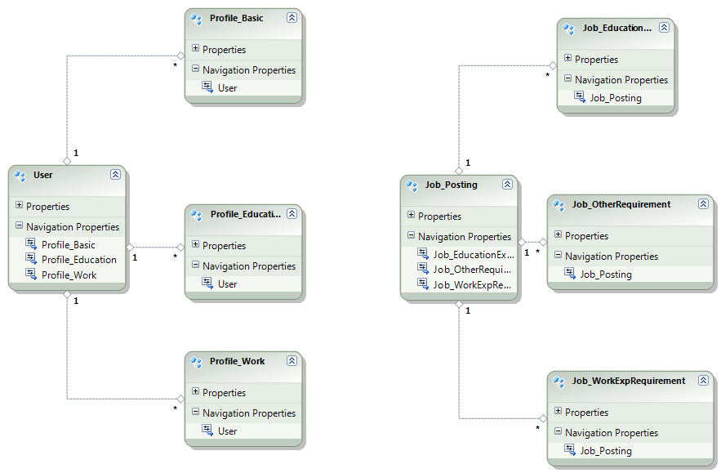
Doanh nghiệp
<<Mô hình thông tin 1>>
Thông tin hồ ứng viên
Hồ sơ công việc
<<Mô hình thông tin 2>>
<<Mô hình thông tin 3>>
Ngành nghề
Vị trí công việc

Slide 19

Mapping
Business Entity
Classes
mô tả
Instance of
Instances
(objects)
Based tag <table>
khởi tạo
End-user

Slide 20
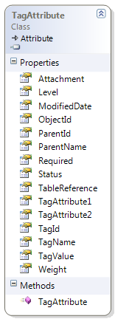
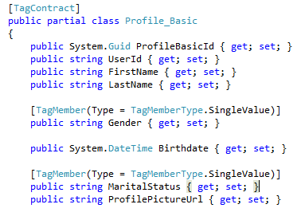
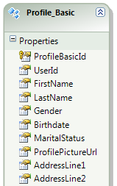
<business entity class>
new instance of
new instance of

Slide 21
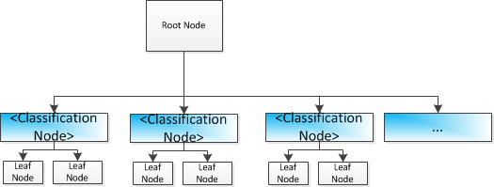
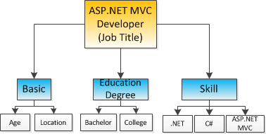
Classification
Abstract
JobZoom Tree
inherit
Overide việc định nghĩa sự ràng buộc các classification node
Custom Tree
new instance
Object
new instance
Object

Slide 22
Điện thoại
Samsung Galaxy S
Màn hình
Hệ điều hành
Màn hình
Hệ điều hành
…
Cảm ứng
5”
Android
Cảm ứng
5”
…
Android

Slide 23

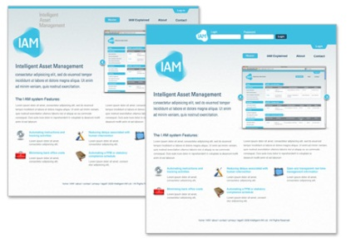


Flexiblity attribute <component>
Use
Recruitment
website
Job seeker
Use library to Implement website
JobZoom framework
API
Decision tree <component>
taxonomy <component>
Developer
Use
others <component>
Employer
JobZoom framework architecture
{components, connectors, constraint}

Slide 24
JOBZOOM FRAMEWORK API
Attribute Mapping Class
Interface
IHierarchyTree
Abstract Hierarchy Tree Class
Interface IJobZoomDataAccess
JobZoomDataAccess
Interface IAnalysisServices
AnalysisServices
Developer
Interface
IDecisionTreeStructure
DecisionTreeStructure
Interface
ISimilarityTerm
SimilarityTerm
Interface
IMatchingTool
MatchingTool

Slide 25



Windows Services Tier
Phân tán các dịch vụ xử lý
Trên nhiều Server
Taxonomy service
Data mining service
use
process
process
JobZoom Framework
Data Tier
use
Analysis Service
JobZoom framework
.Dll Library
query
Client Website (Web Tier)
query
Phân tán:
Data Tier
trên nhiều
Database server
Implement JobZoom framework
.dll library)

Slide 26
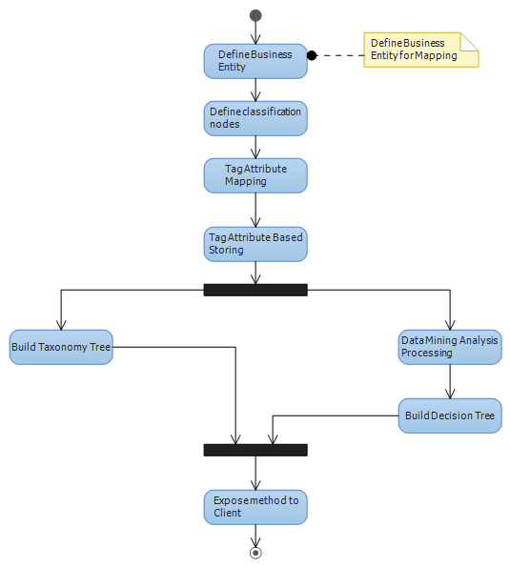

Slide 27
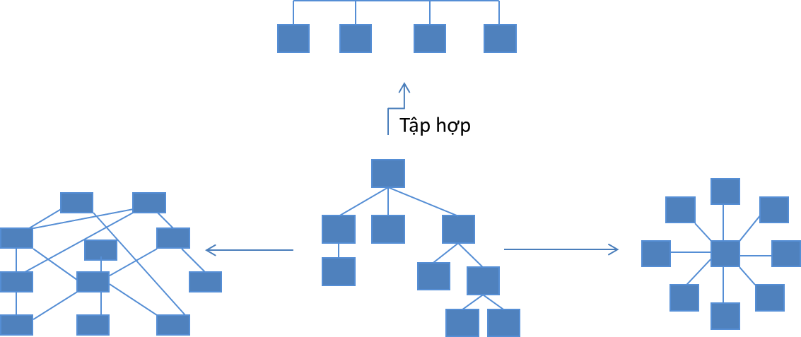

Slide 28
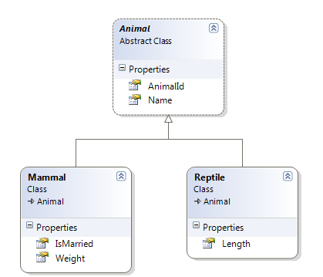
1 cây thông tin
<ObjectId> key
Classification node

